Slide 1
Single Cell and Spatial Proteomics

Slide 2
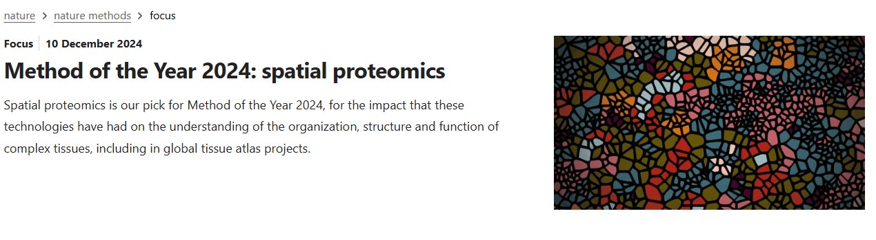

Slide 3
Why Spatial Organization of Proteins is Important
1. Post-Transcriptional Regulation Creates Discrepancies
Proteins and their corresponding mRNAs often show different spatial distribution patterns. This occurs because:
Translation Timing and Location: Protein synthesis doesn't always occur at the same location as the mRNA. Some mRNAs are transported to specific subcellular locations before translation occurs.
Protein Trafficking: After synthesis, proteins can be transported to different cellular compartments through various targeting mechanisms, creating distribution patterns that don't match their mRNA origins.
Protein Stability: Proteins generally have much longer half-lives than mRNA, leading to temporal and spatial discrepancies between mRNA presence and protein abundance.

Slide 4
Why Spatial Organization of Proteins is Important
2. Post-Translational Modifications Change Function
A particularly critical reason to study protein spatial organization is that the same protein can exist in multiple forms with different functions:
Dynamic Modifications: Proteins undergo numerous post-translational modifications (phosphorylation, glycosylation, ubiquitination, etc.) that aren't visible at the mRNA level.
Compartment-Specific Modifications: These modifications often occur in specific cellular compartments, creating functionally distinct protein populations that can't be detected through mRNA analysis.
Functional States: The active or inactive state of a protein is frequently determined by its spatial location in combination with these modifications.

Slide 5
Why Spatial Organization of Proteins is Important
3. Protein-Protein Interactions Are Spatially Regulated
The location of proteins directly impacts their functional interactions:
Protein Complexes: Most proteins function as parts of larger complexes that assemble in specific cellular locations.
Signaling Hubs: The spatial organization of signaling molecules creates microenvironments that facilitate specific pathway activation.
Enzymatic Activities: Many enzymatic reactions require precise spatial positioning of multiple proteins that wouldn't be evident from mRNA data.

Slide 6
Why Spatial Organization of Proteins is Important
4. Disease Relevance
Many pathological conditions involve protein mislocalization rather than just altered expression:
Aberrant Localization: In diseases like cancer and neurodegeneration, proteins often maintain normal expression levels but show abnormal localization.
Aggregation Diseases: Conditions like Alzheimer's and Parkinson's are characterized by protein aggregates forming in inappropriate cellular locations.
Therapeutic Implications: Understanding spatial protein organization can reveal new therapeutic targets focused on correcting localization rather than just expression.

Slide 7
Why Spatial Organization of Proteins is Important
5. Technological Benefits of Protein Analysis
Modern spatial proteomics offers some advantages over spatial transcriptomics:
Direct Functional Assessment: Proteins represent the actual functional molecules, not just the intermediate messenger.
Protein Modifications: Technologies like multiplexed ion beam imaging (MIBI-TOF) and imaging mass cytometry (IMC) can detect both protein presence and modification state.
Higher Stability: Proteins are generally more stable than RNA, sometimes making them more reliable analytes for spatial studies in clinical samples.

Slide 8
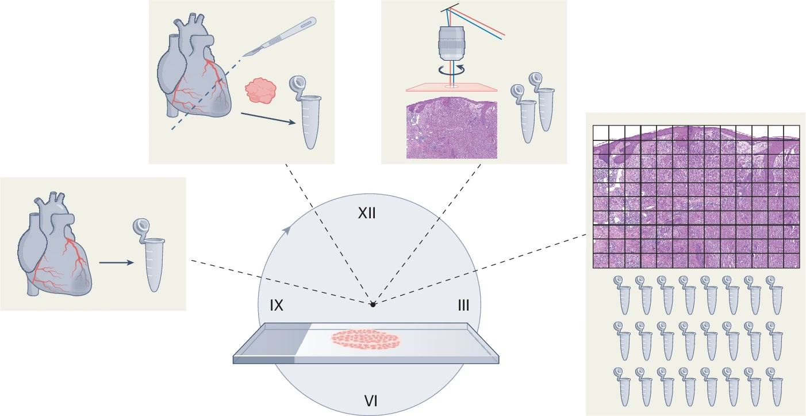
Nordmann et al, Nature Methods 2024
Notes:
his figure illustrates the technological progression of MS-based proteomics over time. The journey begins with bulk tissue analysis (left), which provided averaged protein profiles without spatial context, and proceeds to grid-like approaches with higher spatial resolution (right).

Slide 9
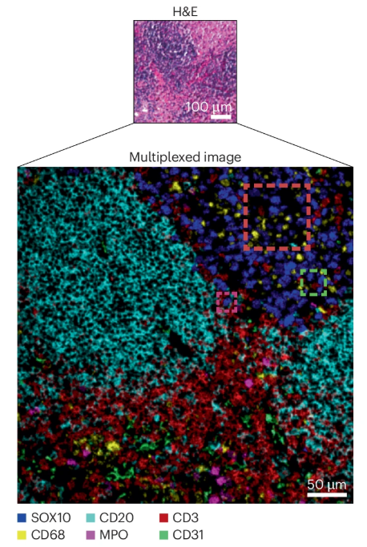
Increasing the information content
H&E stain introduced in 1877.
Hematoxylin stains the nucleus blue-purple
Eosin stains the cytoplasm and extracellular matrix pink
Want to replace it with high spatial resolution information about proteins.
Notes:
H&E staining is a common histological technique used to visualize tissue structures by staining different cell components with two dyes: hematoxylin and eosin. Hematoxylin stains the nucleus blue-purple, while eosin stains the cytoplasm and extracellular matrix pink. This allows pathologists to differentiate between various tissue types and identify abnormalities.

Slide 10
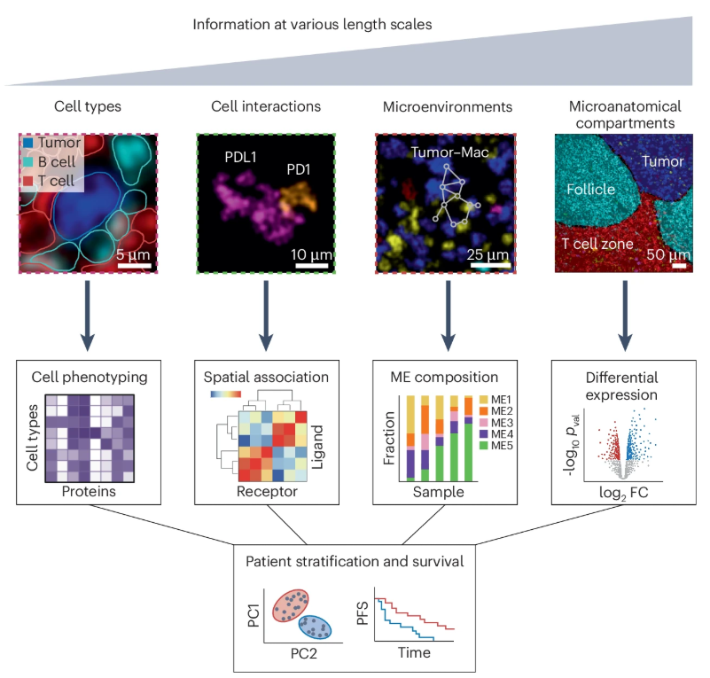
What sort of information can we get out of this?
Bussi, Y., Keren, L. Multiplexed image analysis: what have we achieved and where are we headed?. Nat Methods 21, 2212–2215 (2024).

Slide 11
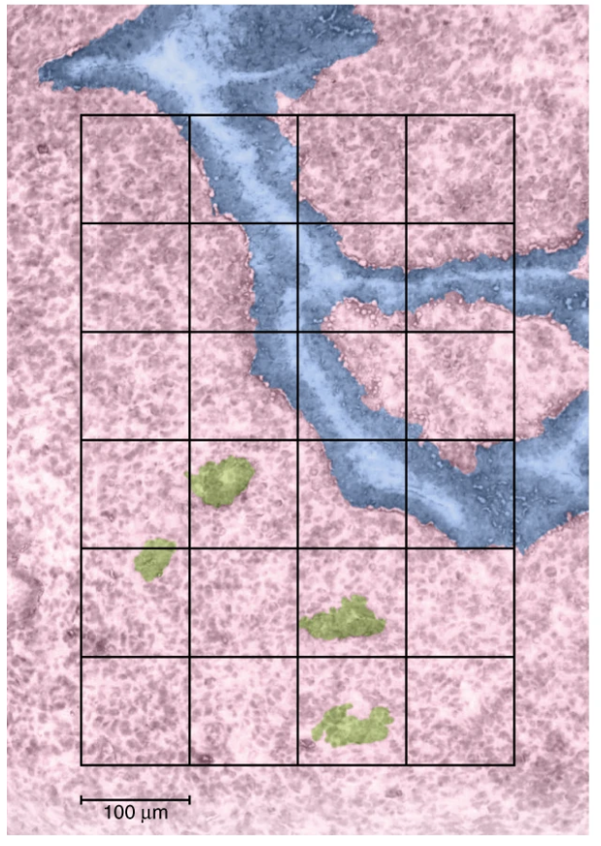
Problems with spatial and single cell proteomics?
We can’t amplify proteins.
As you increase the spatial resolution you decrease the amount of protein.
Increased spatial resolution requires more runs
Proteins are sticky … you lose a portion of protein to every surface they touch.
Proteomics experiments are slow.

Slide 12
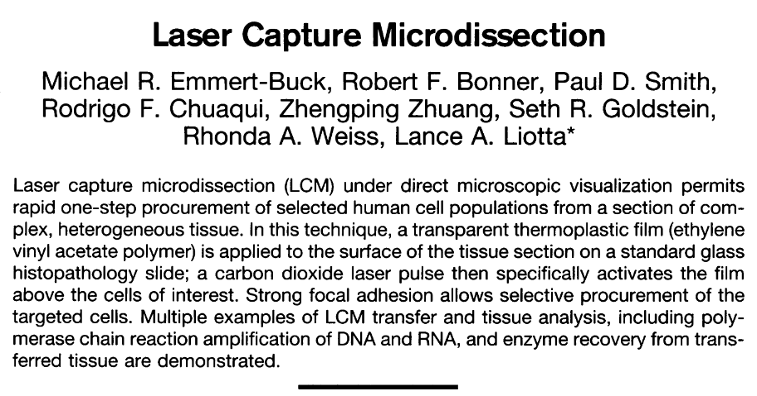
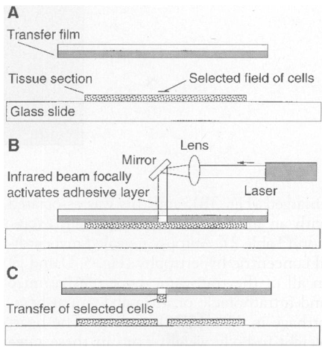
Laser Capture Microdissection circa 1996
Science 1996
Transparent film (ethylene vinyl acetate polymer) applied to tissue sections
CO2 laser to activate the film above cells of interest. Basically used IR laser to melt the plastic
Results in the focal adhesion of the cells to the polymer.
Notes:
Fig. 1. (A) Transparent EVA thermoplastic film isapplied to the surface of a routine tissue sectionmounted on a glass slide. The tissue-EVA filmsandwich is viewed under a microscope, and thecells of interest are positioned in the center of thefield. (B) A focused laser beam coaxial with themicroscope optics is pulsed to activate the film,causing it to become focally adhesive and fuse tothe selected underlying cells in the tissue section.(C) When the EVA film is removed from the tissuesection, the selected cells remain adherent to thefilm surface. The film is then placed directly intothe DNA, RNA, or enzyme buffer. The cellular ma-terial detaches from the film and is ready for stan-dard processing.

Slide 13
Laser Capture Microdissection Today
Started using UV lasers to cut around cells of interest.
Use gravity-assisted collection where cut samples fall into collection tubes.
Faster cutting
Pattern recognition for identifying cells/regions of interest.

Slide 14
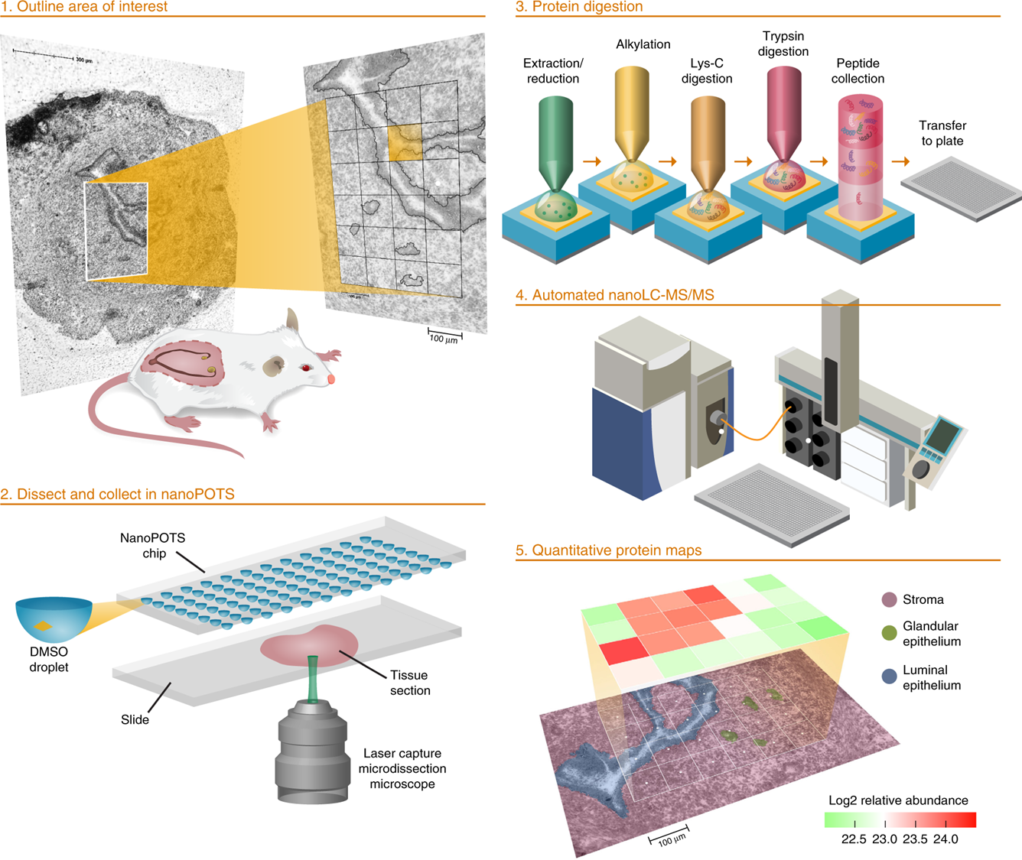
Piehowski et al Nature Communications 2020

Slide 15
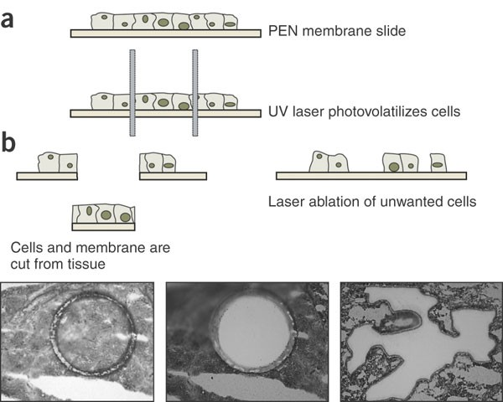
Emmert-Buck et al Science 1996

Slide 16
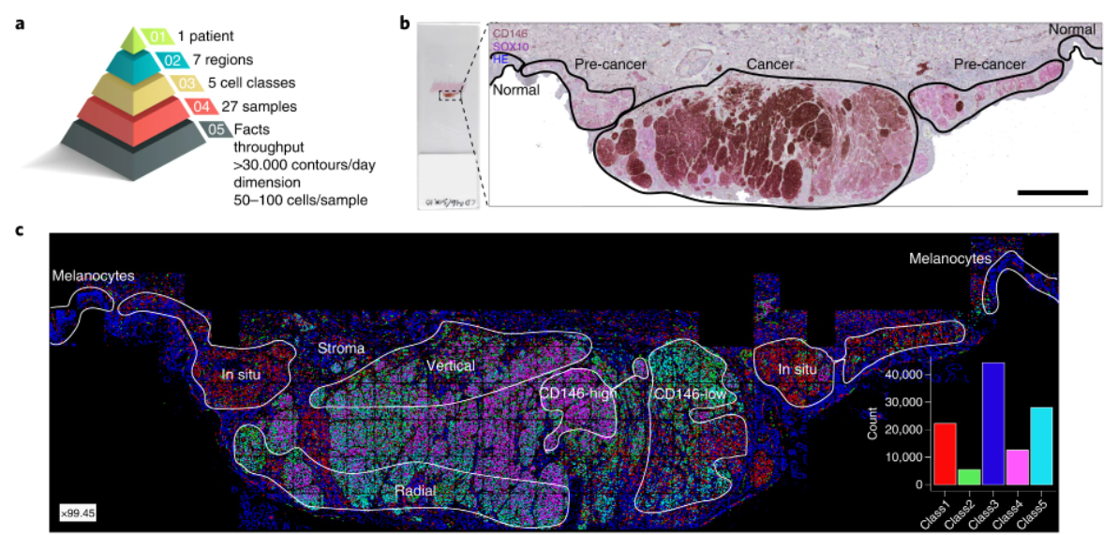
Mund et al Nature Biotech 2022
Notes:
a, DVP sample isolation workflow to profile primary melanoma. b, DVP applied to primary melanoma immunohistochemically stained for the melanocyte marker SOX10 and the melanoma marker CD146. Left panel: stained melanoma tissue on a PEN glass membrane slide. Right panel: pathology-guided annotation of different tissue regions. Scale bar, 1 mm. c, Pathologist-guided and ML-based cell classification based on CD146 and SOX10 staining intensity and spatial localization: normal melanocytes, stromal cells, melanoma in situ, CD146-low melanoma, CD146-high melanoma, radial growth melanoma and vertical growth melanoma. Right lower panel: frequency of classes predicted by unsupervised ML (k-means clustering).

Slide 17
Some statistics
3 million protein molecules per 1 µm³
yeast 30 µm³ = 100 million molecules
HeLa 3000 µm³ (~15 µm diameter) = 10 billion molecules … approx. 200 picograms
Many people focus on ~10-100 cell regions (2-20 ng)

Slide 18
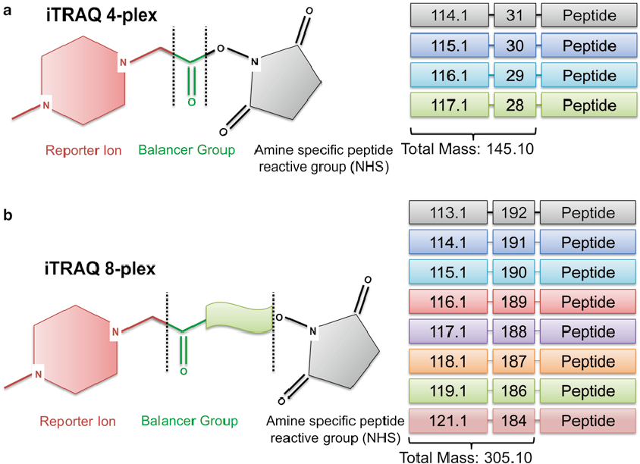
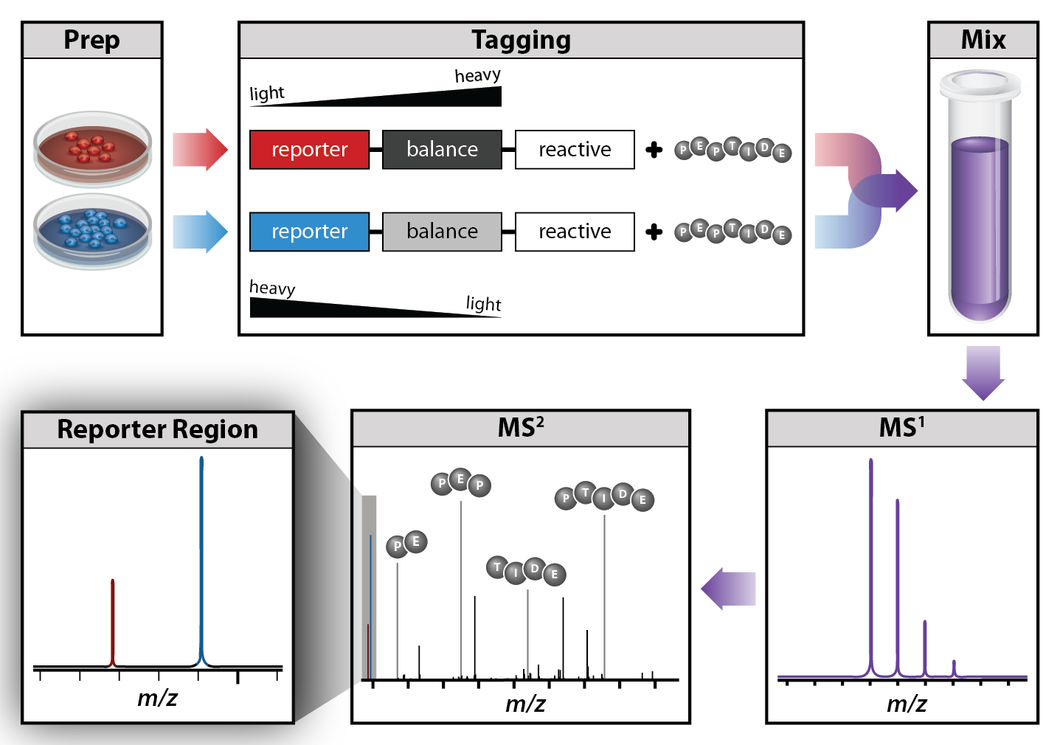
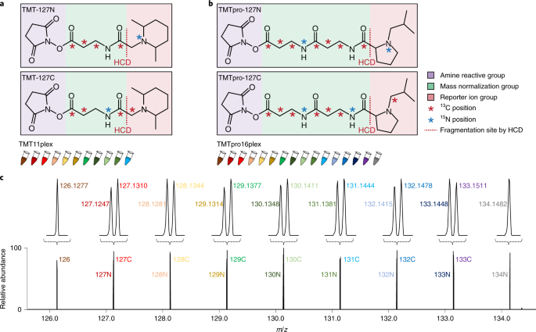
Review: Tandem Mass Tags (TMT)

Slide 19
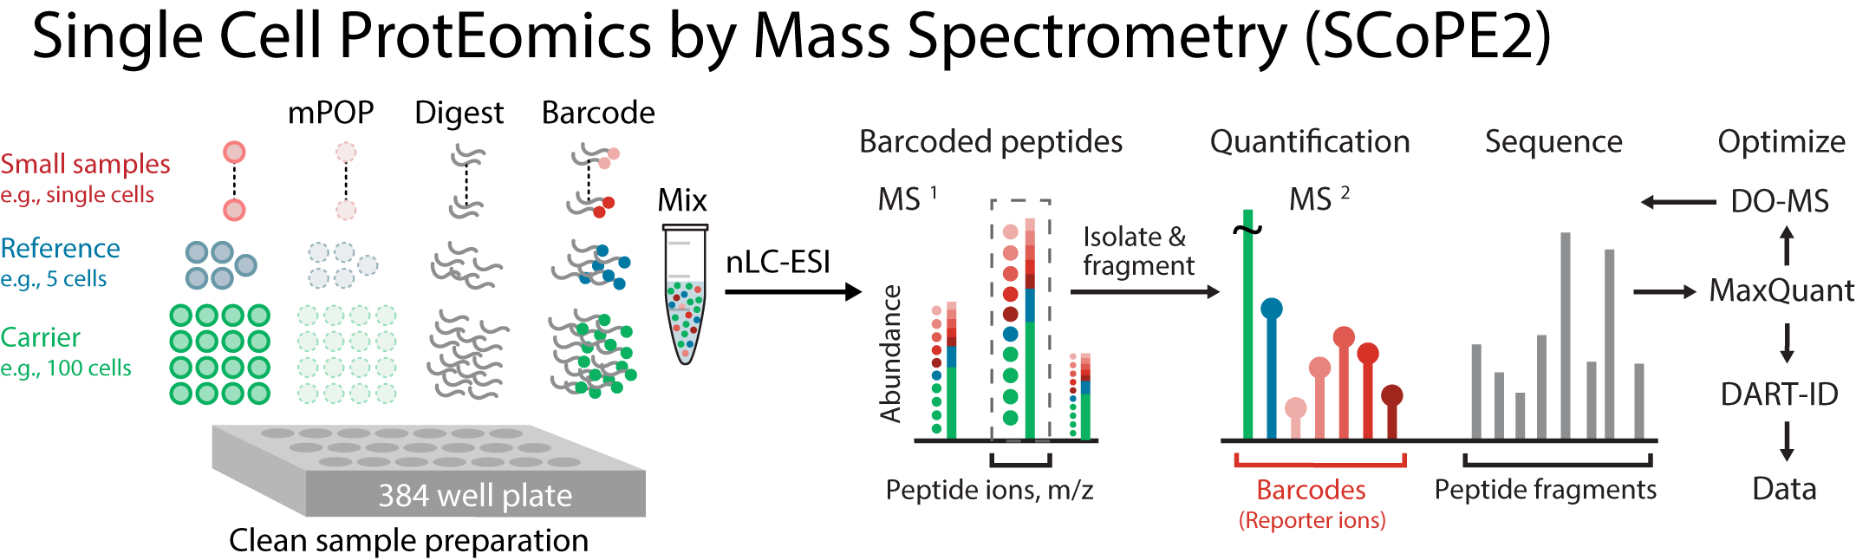

Slide 20
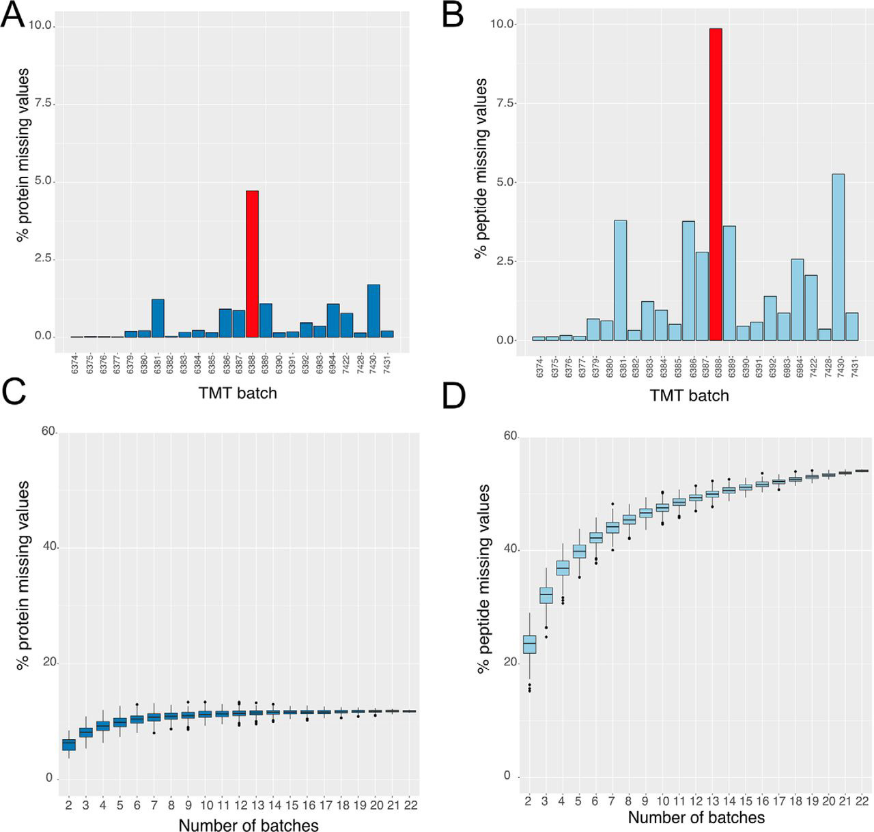
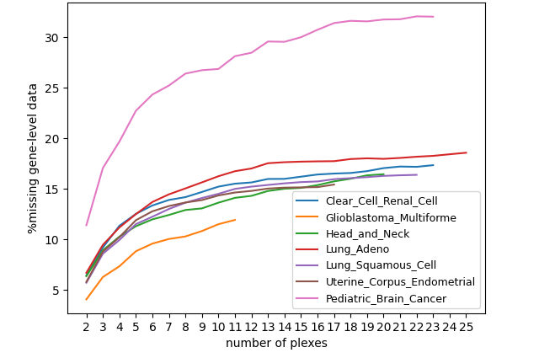
Struggle with Missing Values Between Batches
CPTAC Data
Brenes et al MCP 2019

Slide 21
Flow Cytometry
Technology that measures properties of single cells
Measures fluorescence, light scatter, and other properties of cells and particles
Can provide correlated data that links different population profiles

Slide 22
What can Flow Cytometry Do?
Enumerate particles in suspension
Determine “biologicals” from “non-biologicals”
Separate “live” from “dead” particles
Evaluate 10⁵ to 5x10⁶ particles in less than 1 min
Measure particle-scatter as well as innate fluorescence or 2º fluorescence
Sort single particles for subsequent analysis

Slide 23
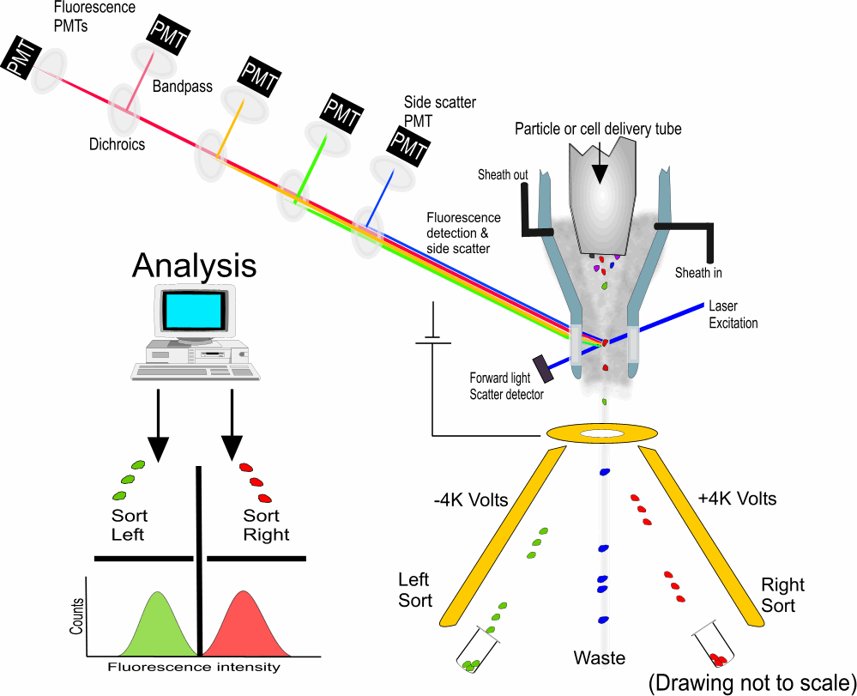
Fundamentals of a Flow Cytometer

Slide 26
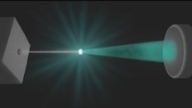
Flow Cytometry

Slide 27
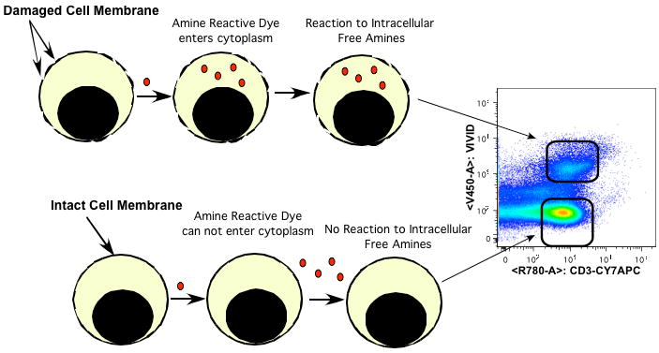
Staining for cell viability
Notes:
propidium iodide (PI), 7-aminoactinomycin D (7-AAD), and DRAQ7 are used to stain non-viable cells. Antibodies exhibit nonspecific binding in dead cells. Greater fluorescence due to increased content of accessible free amines allows dead cells to be easily distinguished from live cells.

Slide 28
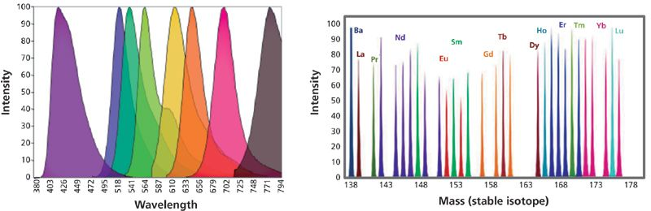
Multiplexing with Heavy Metals

Slide 29
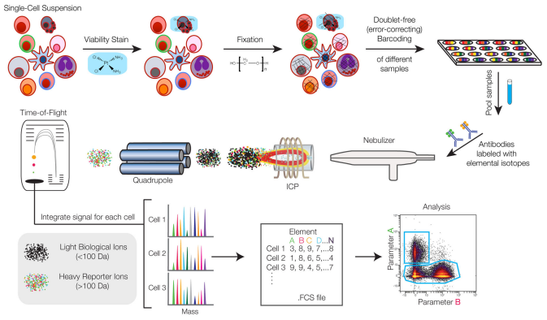
Mass Cytometry
Notes:
propidium iodide (PI), 7-aminoactinomycin D (7-AAD), and DRAQ7 are used to stain non-viable cells. Antibodies exhibit nonspecific binding in dead cells. Greater fluorescence due to increased content of accessible free amines allows dead cells to be easily distinguished from live cells.

Slide 30
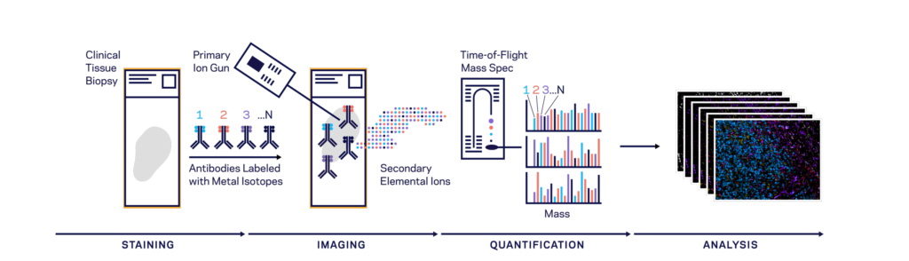
Multiplexed Ion Beam Imaging

Slide 31
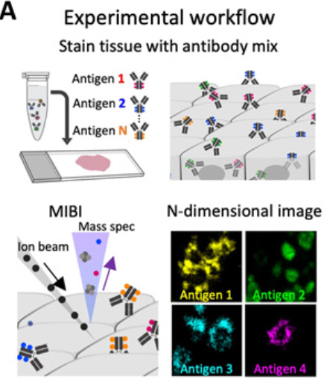

Slide 32
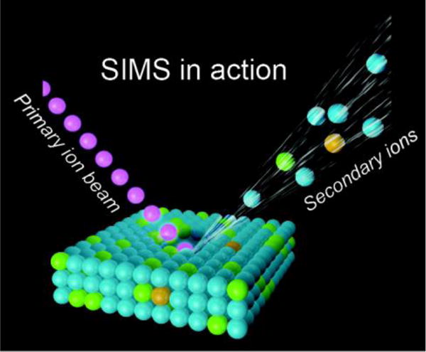
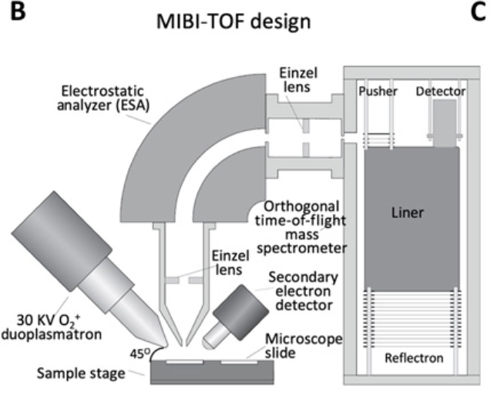

Slide 33
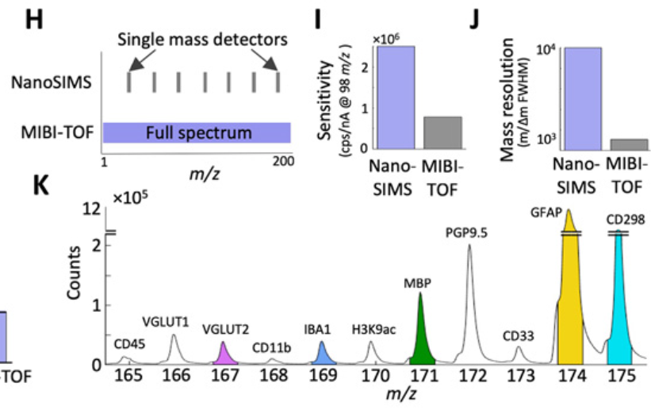

Slide 35
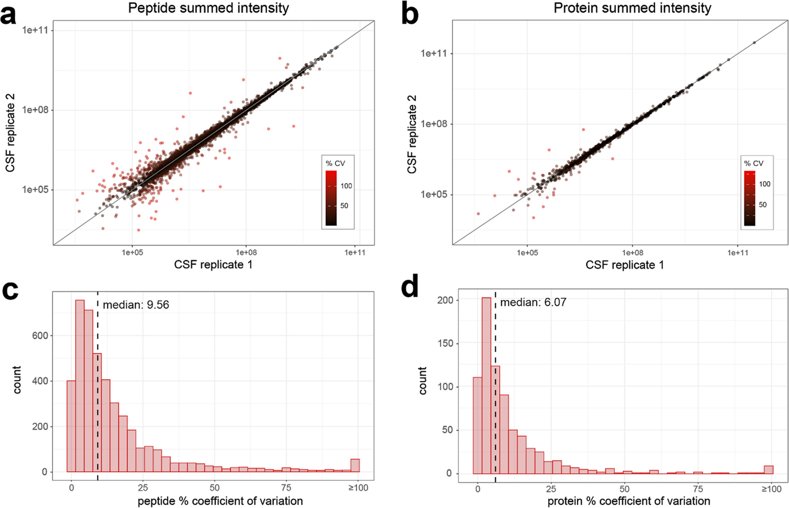

Slide 36
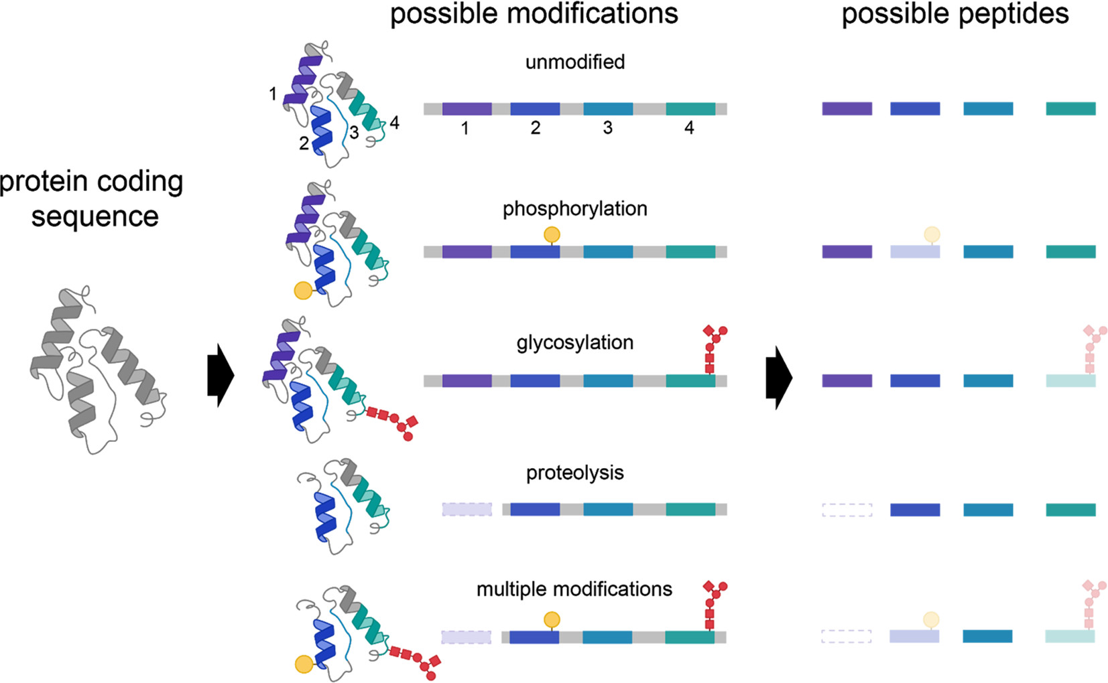

Slide 37
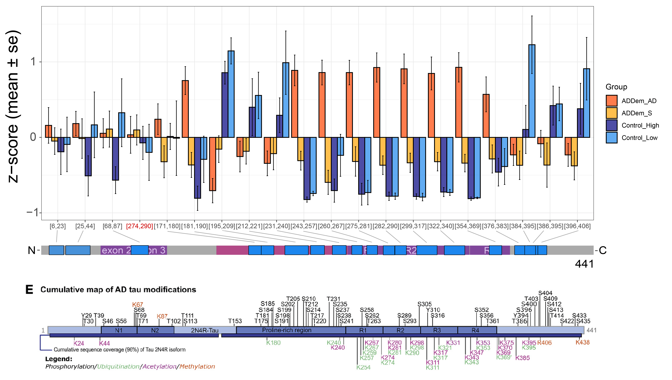
Tau has peptide abundance profiles that differ by domain
Adapted Wesseling et a., Cell 2020
Notes:
Exon 4a – PNS-Tau … Tau that circulates in peripheral nervous system

Slide 38
Tau has peptide abundance profiles that differ by domain
Adapted Wesseling et a., Cell 2020
Notes:
Exon 4a – PNS-Tau … Tau that circulates in peripheral nervous system

Slide 39
Tau has peptide abundance profiles that differ by domain
Adapted Wesseling et a., Cell 2020
Notes:
Exon 4a – PNS-Tau … Tau that circulates in peripheral nervous system

Slide 40
Tau has peptide abundance profiles that differ by domain
Adapted Wesseling et al., Cell 2020
Notes:
Exon 4a – PNS-Tau … Tau that circulates in peripheral nervous system

Slide 41
Tau has peptide abundance profiles that differ by domain
Adapted Wesseling et al., Cell 2020
Notes:
Exon 4a – PNS-Tau … Tau that circulates in peripheral nervous system

